Slide 1
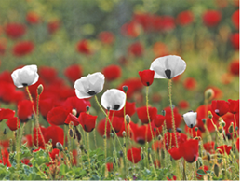
Remembering
for peace

Slide 2
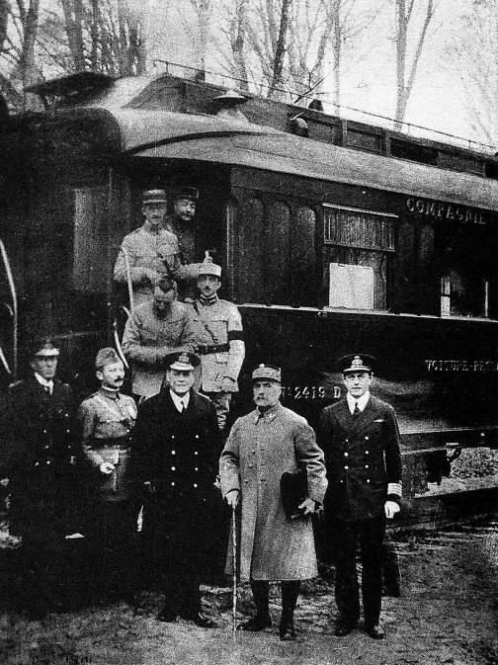
In 1918…
…at the eleventh hour…
…of the eleventh day…
…of the eleventh month,
…World War I stopped.
See page for author [Public domain], via Wikimedia Commons
Notes:
The armistice was signed in a railway carriage.

Slide 3
XII
I
XI
II
X
Have you ever taken part in silent remembrance?
IX
III

Slide 4
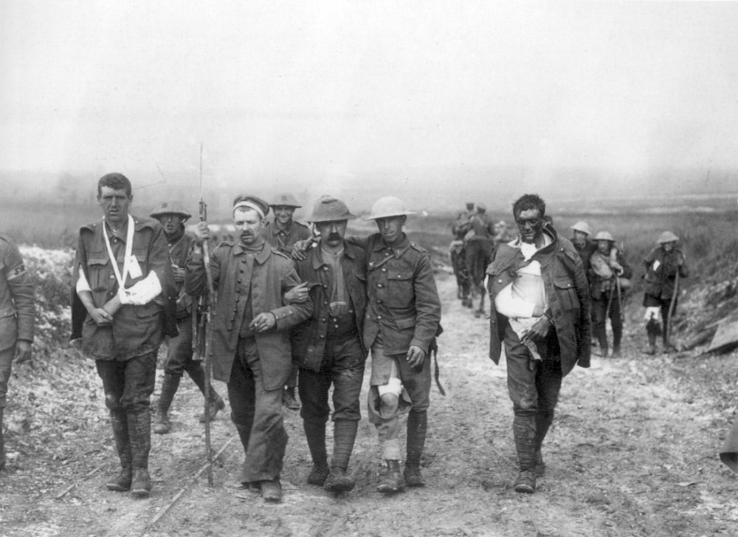
17,000,000 people died in World War I.
59% were military.
41% were civilians.
Ernest Brooks [Public domain], via Wikimedia Commons

Slide 5
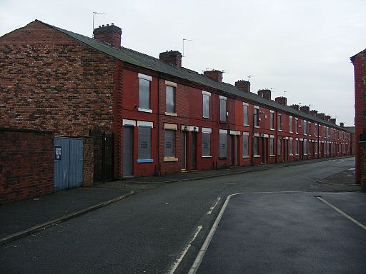

By Ian Roberts (Thursfield Street, Salford Uploaded by oxyman) [CC BY-SA 2.0 (http://creativecommons.org/licenses/by-sa/2.0)], via Wikimedia Commons

Slide 6
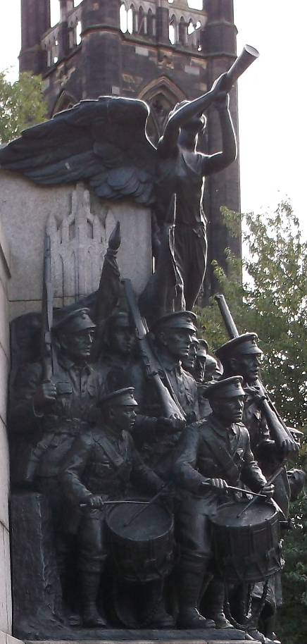
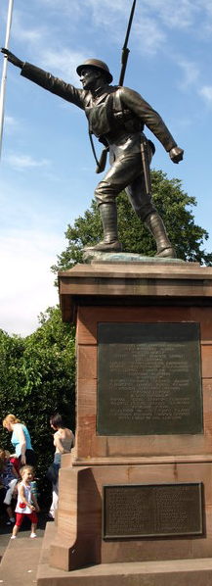
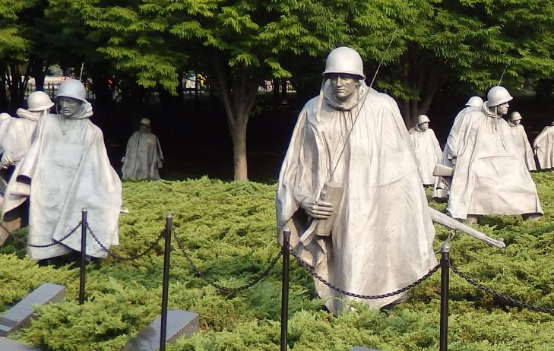
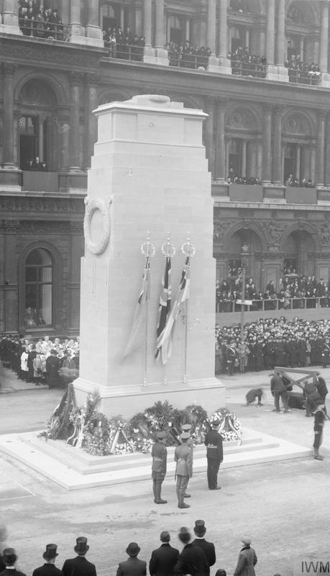
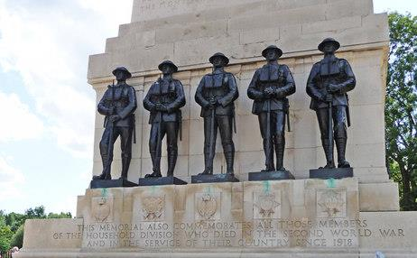
This War Memorial in Newcastle is called the “Response” and shows soldiers setting out to take part in World War 1.
By Aileenw97 (Own work) [CC BY-SA 3.0 (http://creativecommons.org/licenses/by-sa/3.0)], via Wikimedia Commons
Harry Mitchell (Own work) [CC BY-SA 3.0 (http://creativecommons.org/licenses/by-sa/3.0)], via Wikimedia Commons
Lambert [CC BY-SA 2.0 (http://creativecommons.org/licenses/by-sa/2.0)], via Wikimedia Commons
Christine Matthews [CC BY-SA 2.0 (http://creativecommons.org/licenses/by-sa/2.0)], via Wikimedia Commons
By Nicholls, Horace (Photographer) [Public domain], via Wikimedia Commons
Notes:
The Response WWI memorial in Newcastle; WWI Memorial in Bridgnorth; The Korean War Veterans Memorial in Washington DC; the Horse Guards WWI Memorial, London; The Cenotaph, London.

Slide 8
Do the war memorials you have seen represent everyone who has died in war?

Slide 9
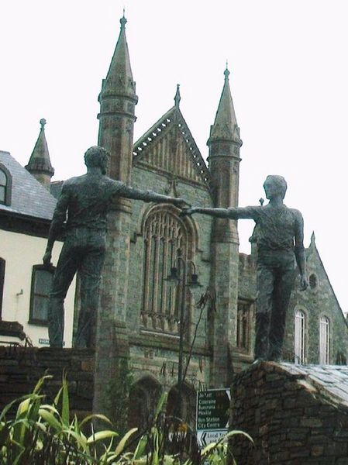
“Hands across the divide”, Northern Ireland.

Slide 10
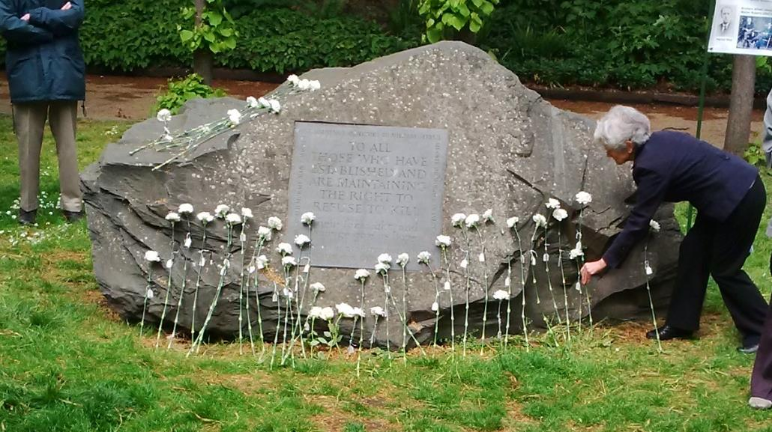

Slide 11
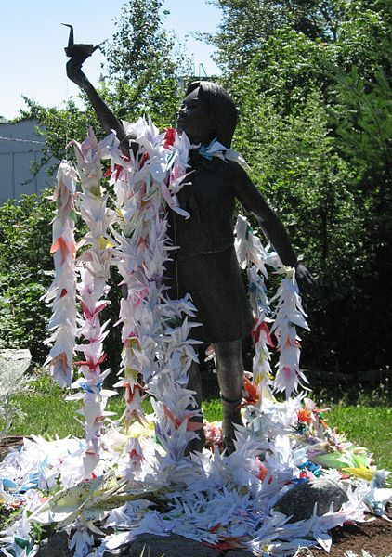
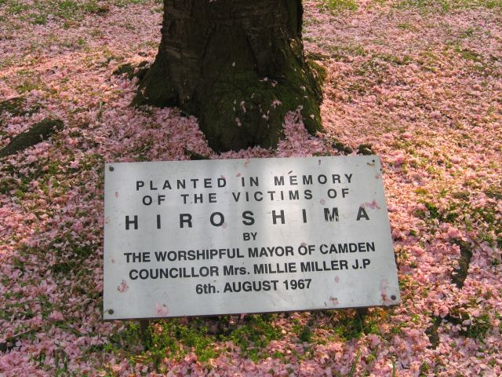
By Lisa Norwood from Portland, OR, USA (A zillion origami cranes for peace) [CC BY 2.0 (http://creativecommons.org/licenses/by/2.0)], via Wikimedia Commons
By The original uploader was MaxHund at English Wikipedia (Transferred from en.wikipedia to Commons.) [GFDL (http://www.gnu.org/copyleft/fdl.html) or CC-BY-SA-3.0 (http://creativecommons.org/licenses/by-sa/3.0/)], via Wikimedia Commons
Notes:
The statue of Sadako Sadaki in Hiroshima and the base of the Cherry Tree for the Victims of Hiroshima’s atomic bombing in Tavistock Square, London

Slide 12
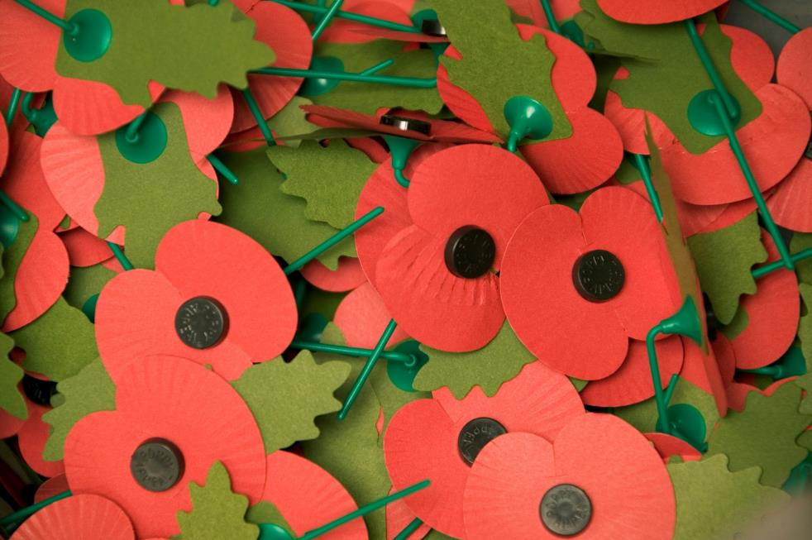
Photo: Mike Weston ABIPP/MOD [OGL (http://www.nationalarchives.gov.uk/doc/open-government-licence/version/1/)], via Wikimedia Commons

Slide 13

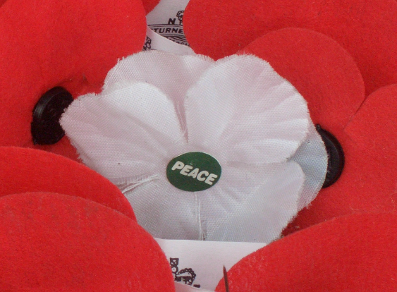

By User:Nankai (File:Anzac poppies.JPG) [CC BY-SA 3.0 (http://creativecommons.org/licenses/by-sa/3.0)], via Wikimedia Commons

Slide 14
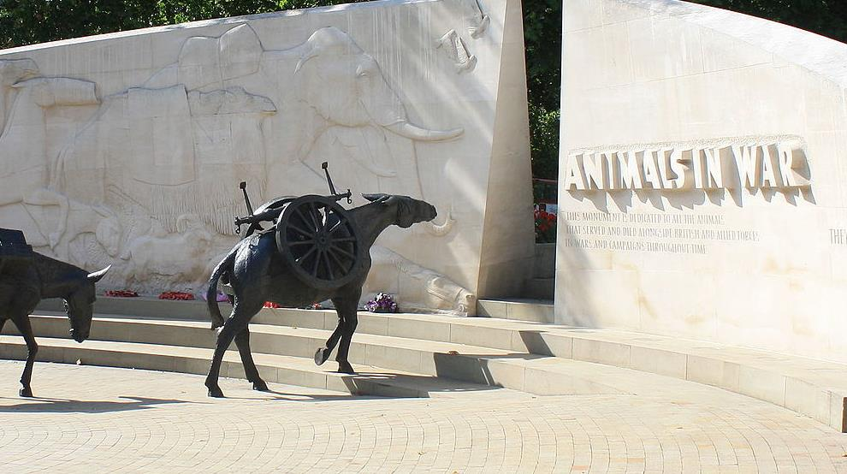
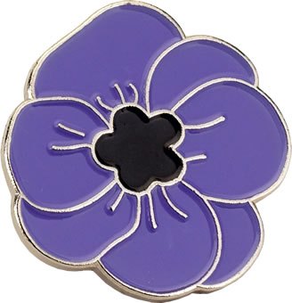
By Dario Crespi (Own work) [CC BY-SA 4.0 (http://creativecommons.org/licenses/by-sa/4.0)], via Wikimedia Commons
Notes:
A purple poppy and London’s memorial for animals in war

Slide 15
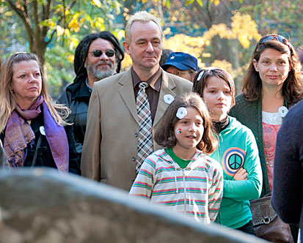
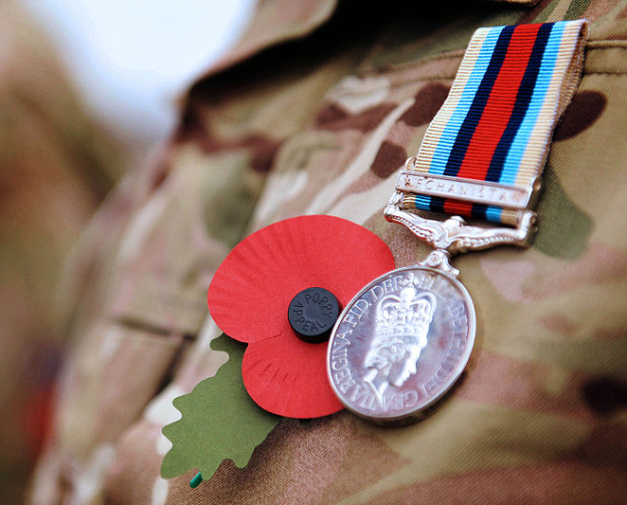
How will you remember?
Photo: Cpl Paul Morrison/MOD [OGL (http://www.nationalarchives.gov.uk/doc/open-government-licence/version/1/)], via Wikimedia Commons

