Slide 1

How to build your
Peace Week
These slides are part of the staff training session (Pt.3) of Peace Week from Quakers in Britain. Find full resources at www.quaker.org.uk/peace-week

Slide 2
Peace Week can be any time in the school year. It is a chance for the whole school to come together as one community for learning about, experiencing, and celebrating peace. This workshop is designed to help you plan for it.

Slide 3

Aims
gather staff hopes and expectations
link to and develop your school’s vision of peace or school values
unpack the different dimensions of peace – the sense that Peace Week has many parts, but they fit together to make a whole.

Slide 4
definitions
discuss in pairs your definitions of peace, conflict and violence,

Slide 5

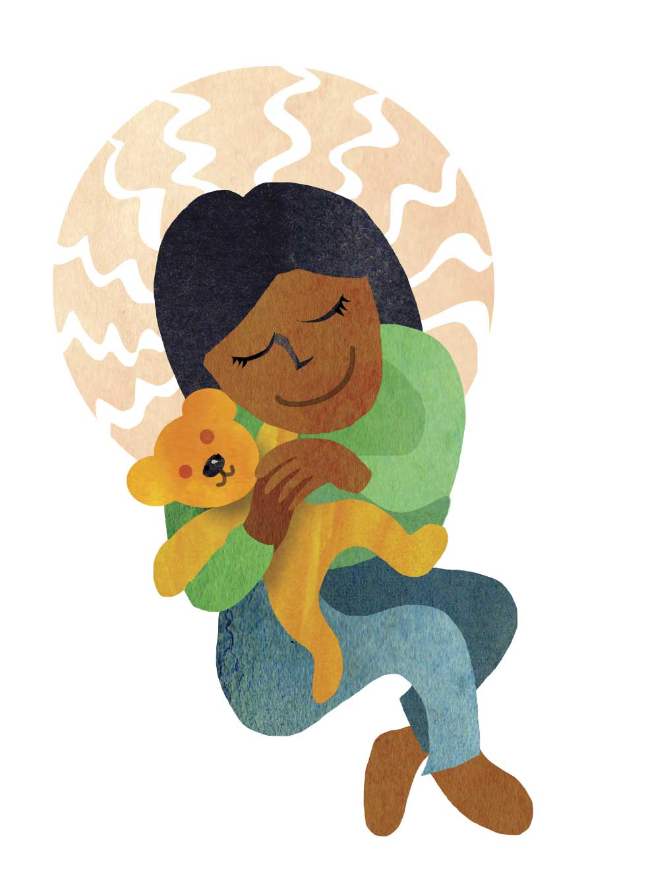
Imagine a peaceful school
What do you see, hear, feel?

Slide 6


Slide 7

Harmful conflict

Slide 8
Helping peace
HELPFULNESS →

Slide 9
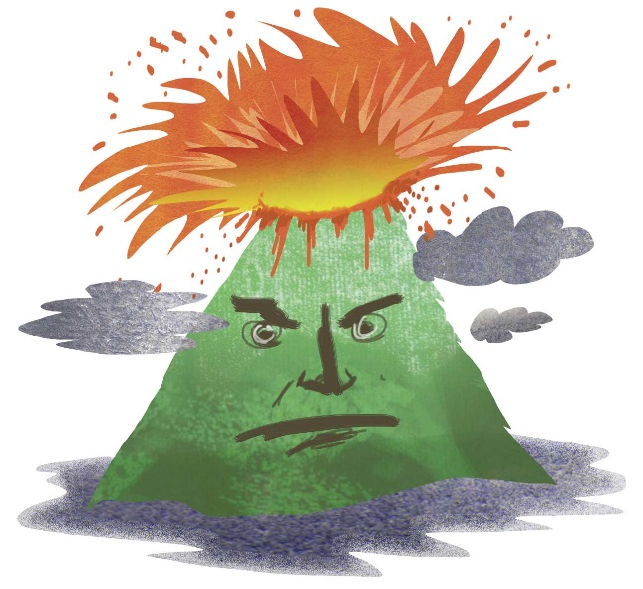
The conflict escalator

Slide 10

Conflict Style Map

Slide 11
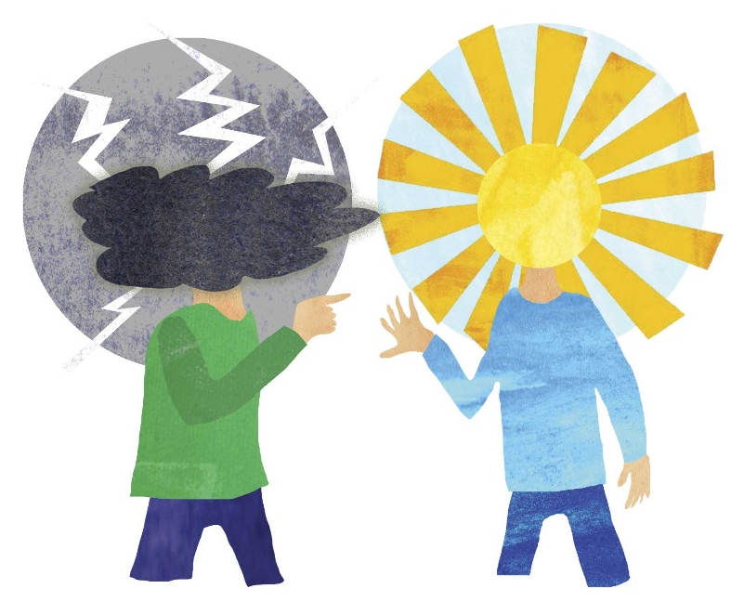
The conflict onion

Slide 12

resources
Whether you want to explore transforming conflict, conscientious objection or human rights, there are great resources and organisations to help.

Slide 13


