Slide 1
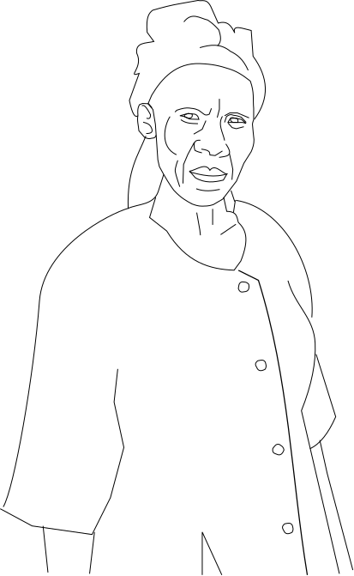
Non-violence in action: Mama Zepreta’s House

Slide 2
Mama Zepreta with her family

Slide 3
Mama Zepreta in the ruins of her house
Her sign says:
“Zepreta Atamba- victim of injustice.
“We, the Human Rights Fraternity, are calling for” respect for the law and human rights.

Slide 4
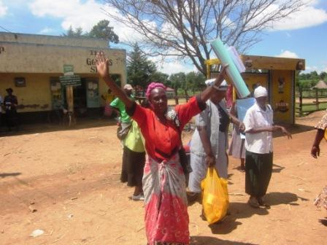
Mama Zepreta and her friend
Persuade the village to help

Slide 5
The village joined Mama Zepreta’s campaign

Slide 6
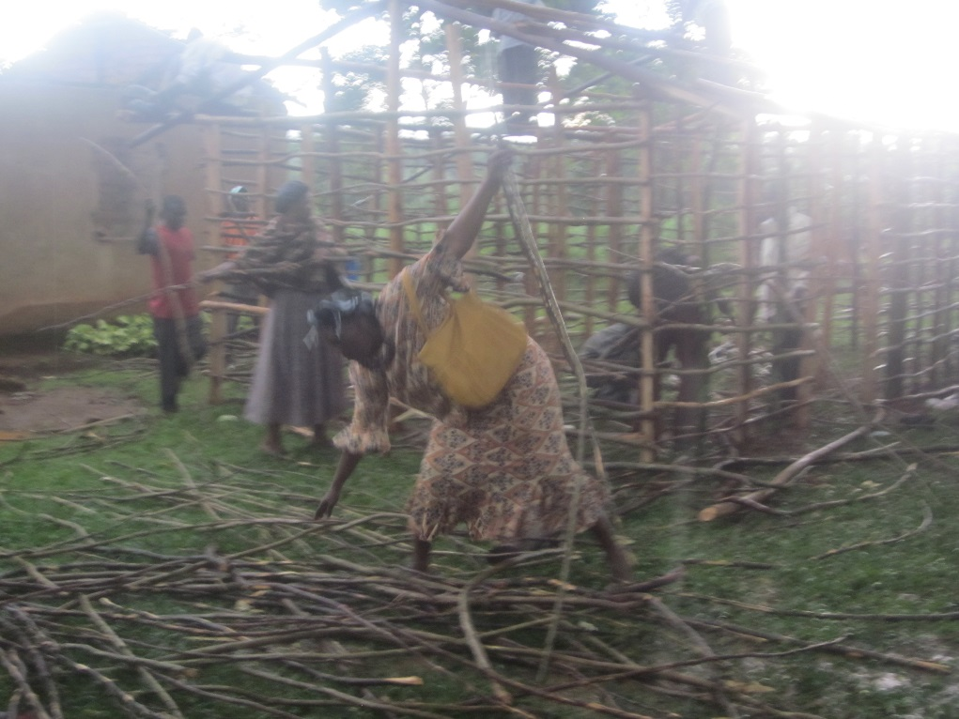
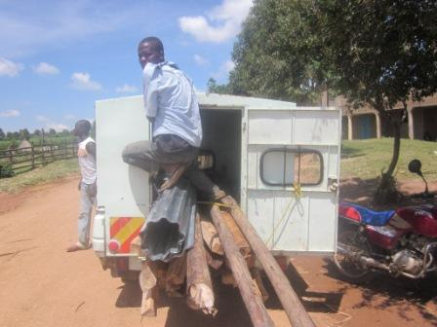
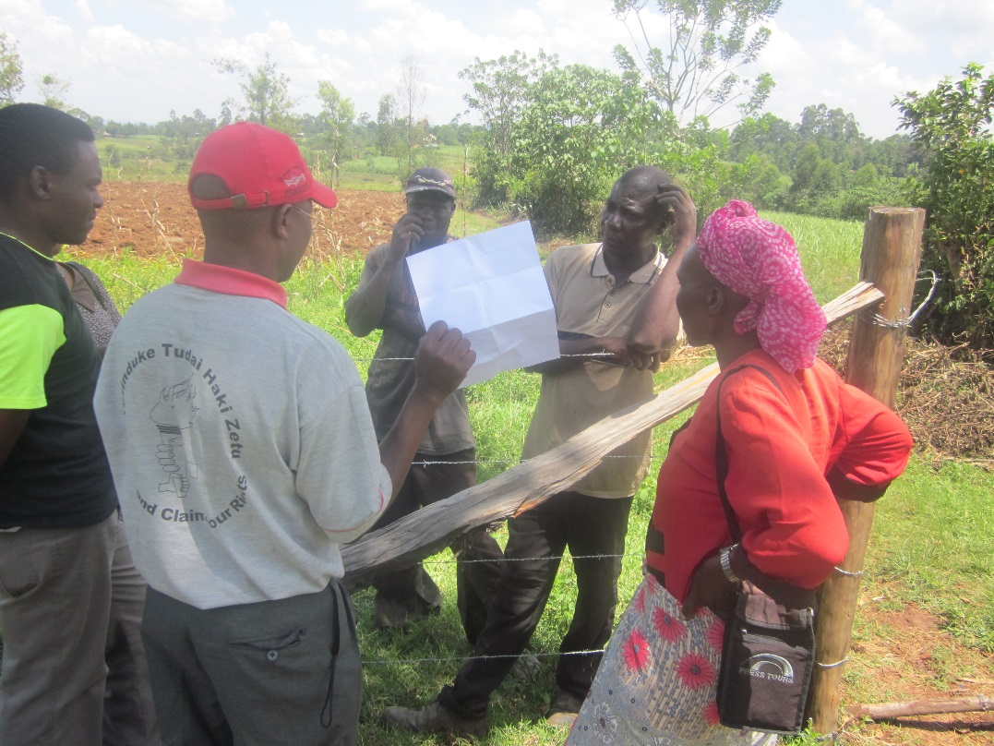
Rebuilding the house

Slide 7
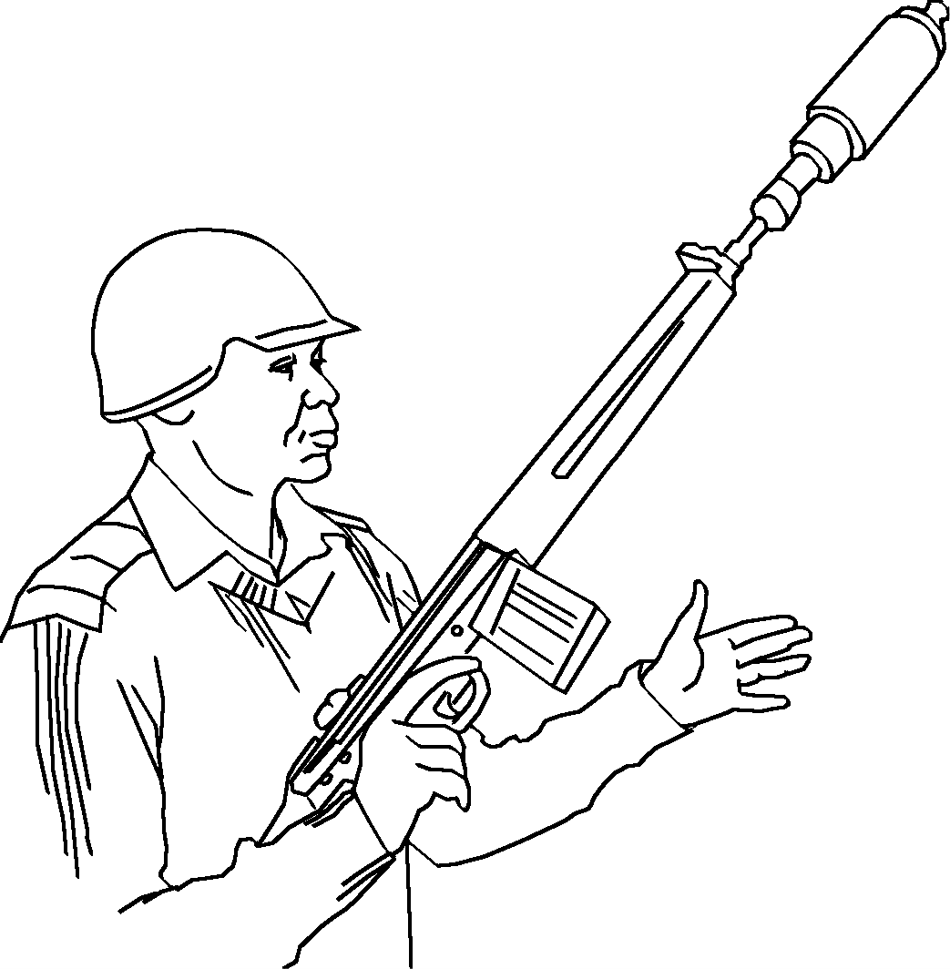
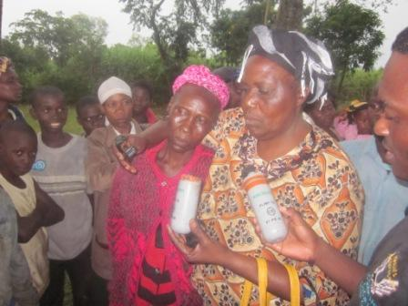
The police came with guns and tear gas

Slide 8
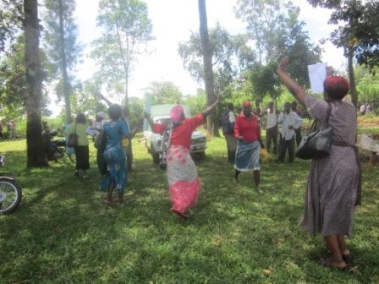
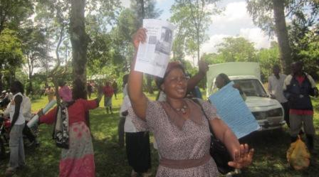
The village celebrates

