Slide 1
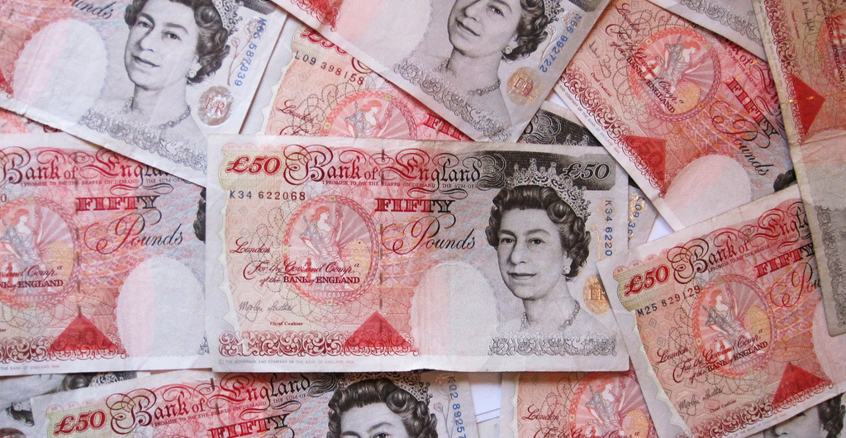
Budget for a safer world
How would you spend £45,000,000,000 to make the world safer?
In this lesson, you will decide. You will use pie charts, percentages and most of all your own decision-making.
A pile of 50 pound notes by Images Money via Flickr https://www.flickr.com/photos/59937401@N07/5474155241/in/photolist-9kJtCV-8pup2p-cSKvfU-6SKbGu-aXTBnX-8pupSi-9kP6MU-9kJuve-a31WN9-9kMMvL-6mTeY9-8KL9Ff-6SKbxo-gfgyLd-qSVCq4-qEw1kK-kdsbzK-9VMgvz-9VAmAB-8PY4BV-nox1UK-yqVyYs-4icUAV-gNDKEw-g94mvD-472wmB-oPTnLV-9VzCaq-ijY8gT-CfKk8R-9BDELm-5eD1KB-tsGXem-5mbc1H-69hd1g-xchm6-4ohhPn-diomHS-dQUfrx-ru8N8R-9YonaS-bYfzb5-5rjH75-6kRjvB-4kA75h-9VC9zS-vqoNF-hwzgqu-7RE6oi-iQE4JN/

Slide 2
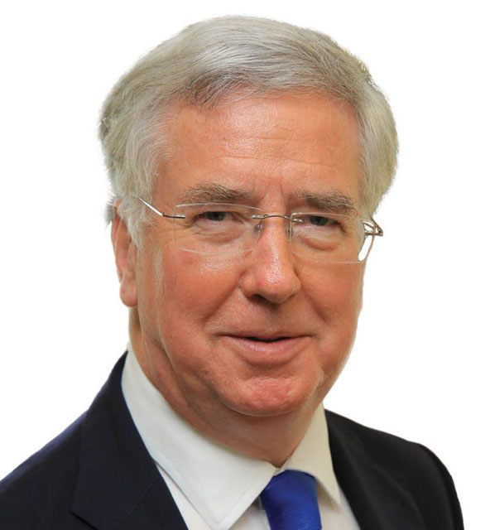
What the UK government says:
“We’re increasing defence spending.
“Over the next decade we plan to spend more than $265 billion on new [military] equipment.
“…at a time of growing threats the UK is stepping up with bigger, stronger defence.”
“We’re the only major country choosing to spend 2% of GDP on defence and meeting the… goal of at least 0.7% on development.” (2015)
Michael Fallon, Secretary of Defence
Image of Michael Fallon: By Ministry of Defence - https://www.gov.uk/government/people/michael-fallon, OGL 2, https://commons.wikimedia.org/w/index.php?curid=34404866
Notes:
Speech by Michael Fallon, Secretary of State for Defence 2015 https://www.gov.uk/government/speeches/stronger-defence-in-a-more-dangerous-world
The last paragraph quoted here is quite stretching in terms of language, using terms like “GDP” (Gross Domestic Product- the total money generated by the whole country), but it gives a sense of the way percentages are discussed.
2% is judged significant because it is the amount NATO (The North Atlantic Treaty Organisation) asks of members.

Slide 3
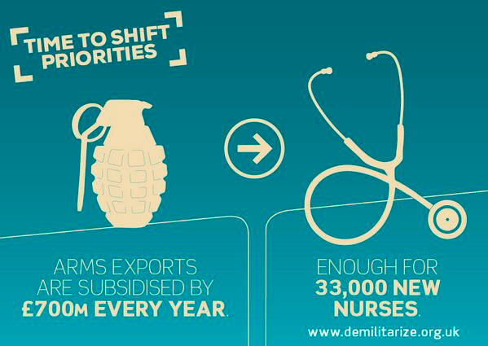
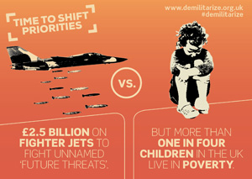
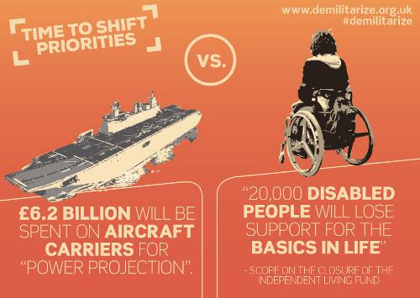
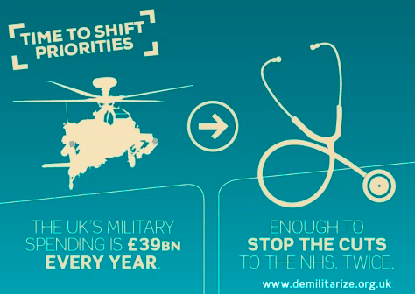
What critics say
“For too long we have lived with the myth that high military spending maintains peace, creates jobs and combats terrorism. This myth is promoted by governments and by multinational arms companies who benefit from the global arms trade…. It prevents the money being spent on tackling real challenges such as relieving poverty, improving health, and protecting the environment.”
-Global Campaign on Military Spending website demilitarize.org.uk

Slide 4
Where do you stand?
The $1.7 trillion which the world spends on the military should be shifted to help people and the environment.
0% Agree
100% Agree
Notes:
Military spending to be shifted towards social and environmental needs. - https://demilitarize.org.uk/about/

Slide 5
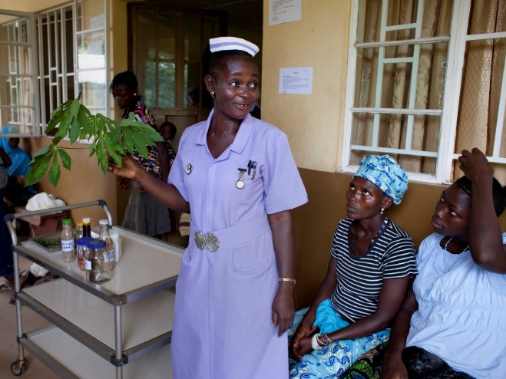
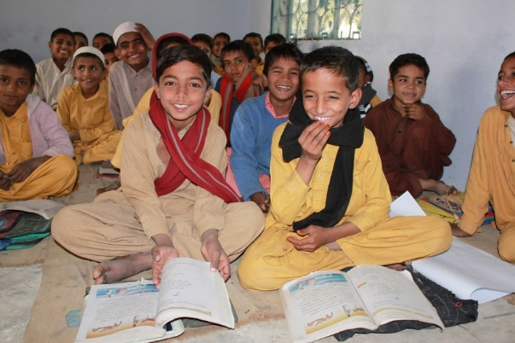
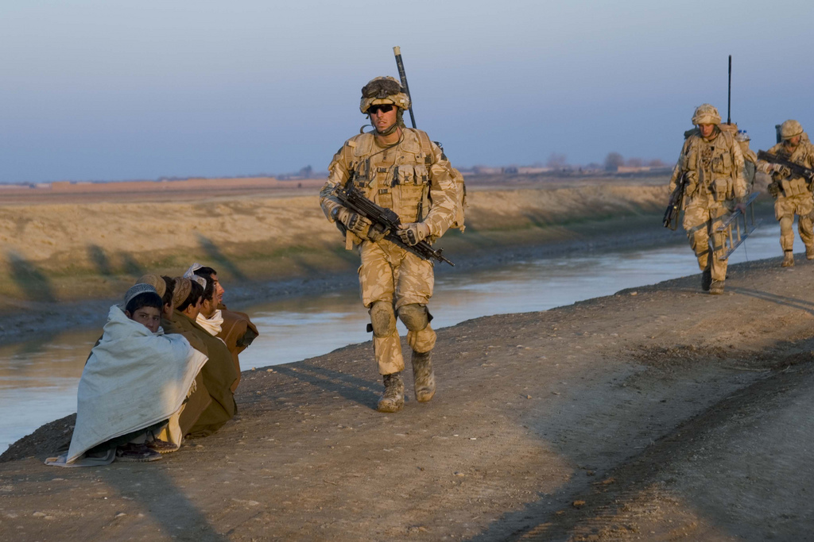
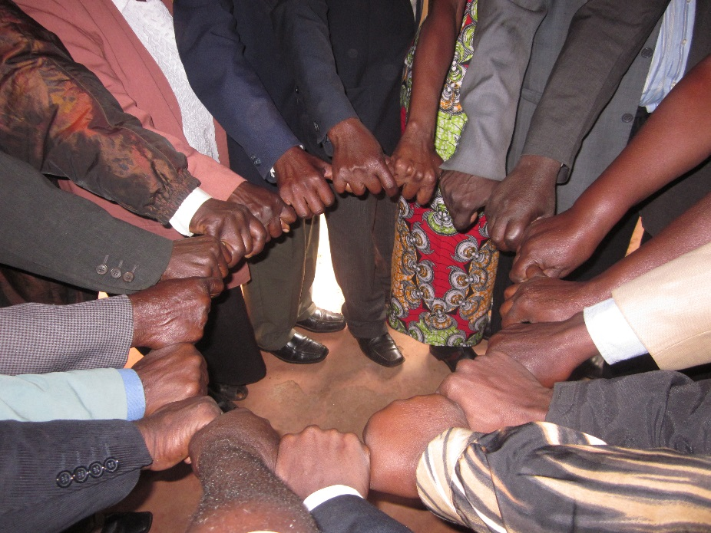
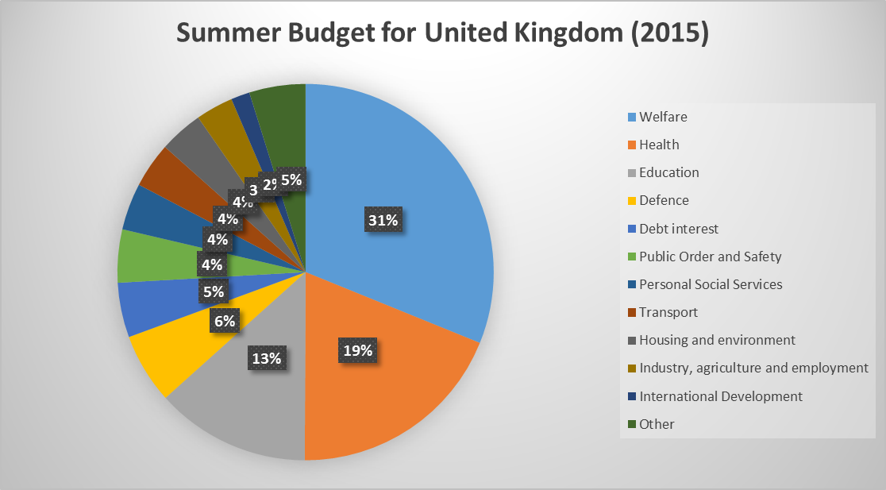
Click on an image to zoom and get more information
Budget

Slide 6
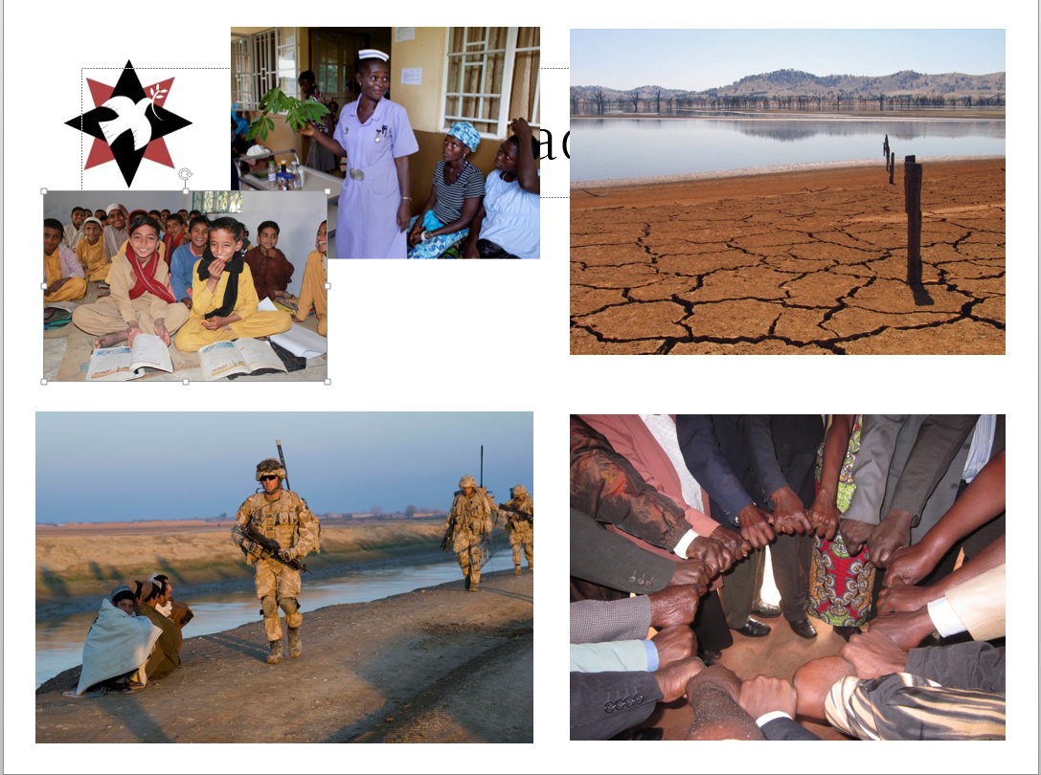
Sending the military overseas as in Iraq, Afghanistan and Libya
The war in Afghanistan had cost the UK £25-37 billion by 2013
Building and selling more weapons to other countries
Recruiting people into the armed forces
Keeping “Trident” nuclear weapons on submarines
Belonging to the “NATO” Alliance
Arms and military
intervention
Image of British troops in Afghanistan from ResoluteSupportMedia
BACK
Notes:
More information about the cost of the Afghanistan War : http://www.theguardian.com/world/2013/may/30/afghanistan-war-cost-britain-37bn-book
NATO stands for North Atlantic Treaty Organisation, an alliance of countries committed to defending each other. Members are supposed to spend 2% of their GDP on the military.

Slide 7
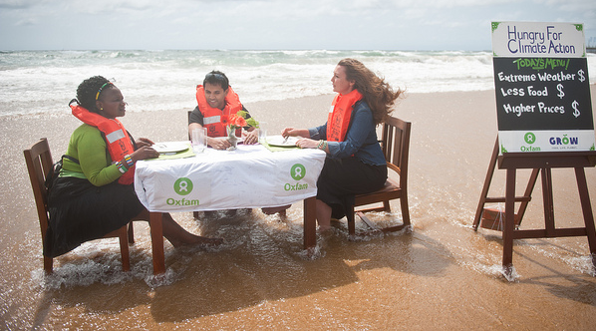
Finding new sources of energy
Investing in technologies that protect the planet and its people
Help people suffering because of drought and flooding
Oxfam believes £518bn could be needed to help people survive in poor countries before 2050
Tackling climate change
Oxfam hungry for climate action at Durban Climate Conference via Flickr
Tim J Keegan took this shot of a lake in Australia at just 4% of its original depth via Flickr.
BACK
Notes:
More information from Oxfam’s 2015 report: http://www.oxfam.org.uk/media-centre/press-releases/2015/11/delays-in-cutting-emissions-set-to-cost-developing-countries-hundreds-of-billions-of-dollars-more

Slide 8
Diplomacy- getting governments and leaders talking, not fighting
Conflict prevention- working with people to find solutions before things get too hot!
Training peacemakers-people who know how to use nonviolence to change things for the better
Peacebuilding
BACK
Grassroots peacebuilding work in Western Kenya- photo from Quaker Peace & Social Witness

Slide 9
Building hospitals and train nurses and doctors so people are safer from injury and disease
Help people to earn a living so they can look after themselves
Invest in education so people learn about the world around them
Health
This photo from the H4+ Partnership shows a student midwife in a hospital in Sierra Leone
Education
This photo from DFID of a school in Pakistan
Budget
BACK

Slide 10
UK Budget
See Li Photo Capital www.seeliphotocapital.com/ seeliphotocapital.virb.com/
London Pictures Capital | londonpicturecapital.weebly.com/
Notes:
More info: https://demilitarize.org.uk/wp-content/uploads/Budget-2015.pdf
Full Michael Fallon speech: https://www.gov.uk/government/speeches/stronger-defence-in-a-more-dangerous-world

Slide 11
UK Budget
Defence receives £45 Billion (45,000,000,000)

Slide 12
Defence
“We protect the security, independence and interests of our country at home and abroad”
In 2015, the Ministry of Defence was given £45 billion for this.
Notes:
What does security mean?

Slide 13
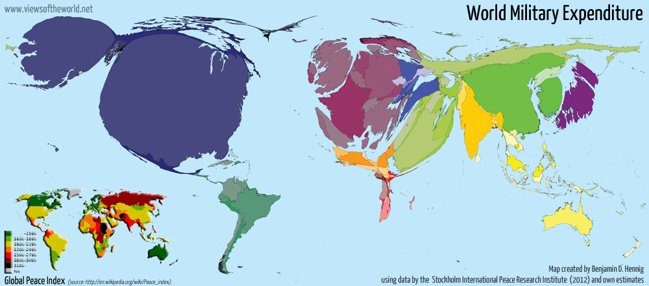
Global military spending
The World spends $1.7 trillion dollars on the military.
That’s $1,700,000,000,000
The United Kingdom is ranked the sixth biggest spender
Notes:
This strange looking map alters the size of countries based on how much they spend on the military- the higher the military spending the bigger the country
Can you see the UK? What do you notice about it? What other countries do you recognise?
More information about this map can be found at: http://www.viewsoftheworld.net/?p=3363
https://www.youtube.com/watch?v=MBGeBlsiSMU

Slide 14
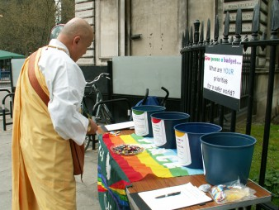
Let’s vote

Slide 15
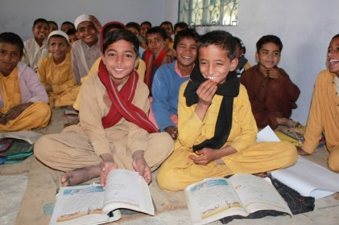
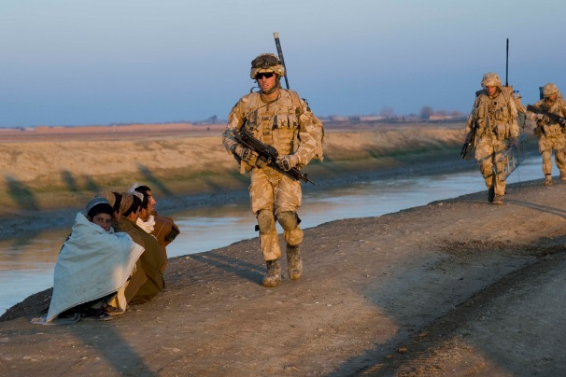
Results
To update the chart, leave presentation mode, right click the pie chart and select “edit data” (or you can use the Excel Spreadsheet)
Notes:
Go to http://bit.ly/GDAMS-Submit-2016 to add your results to the national survey

