Slide 1
Fly Kites Not Drones

Slide 2
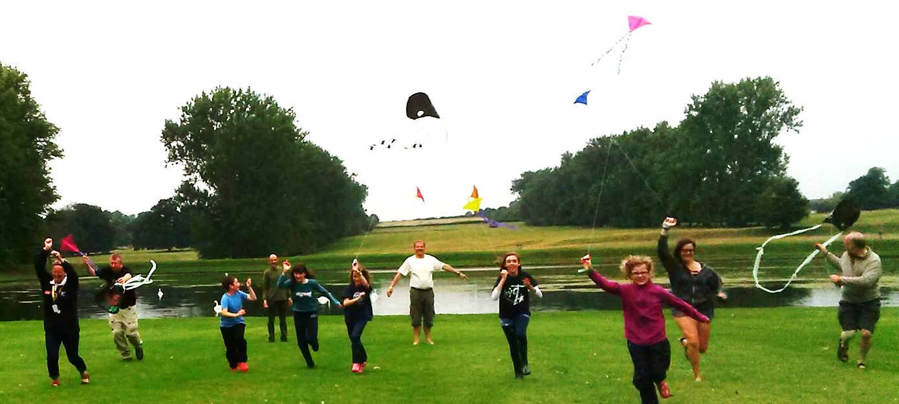
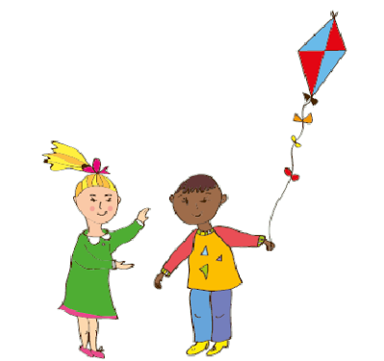
Have you ever flown a kite?

Slide 3
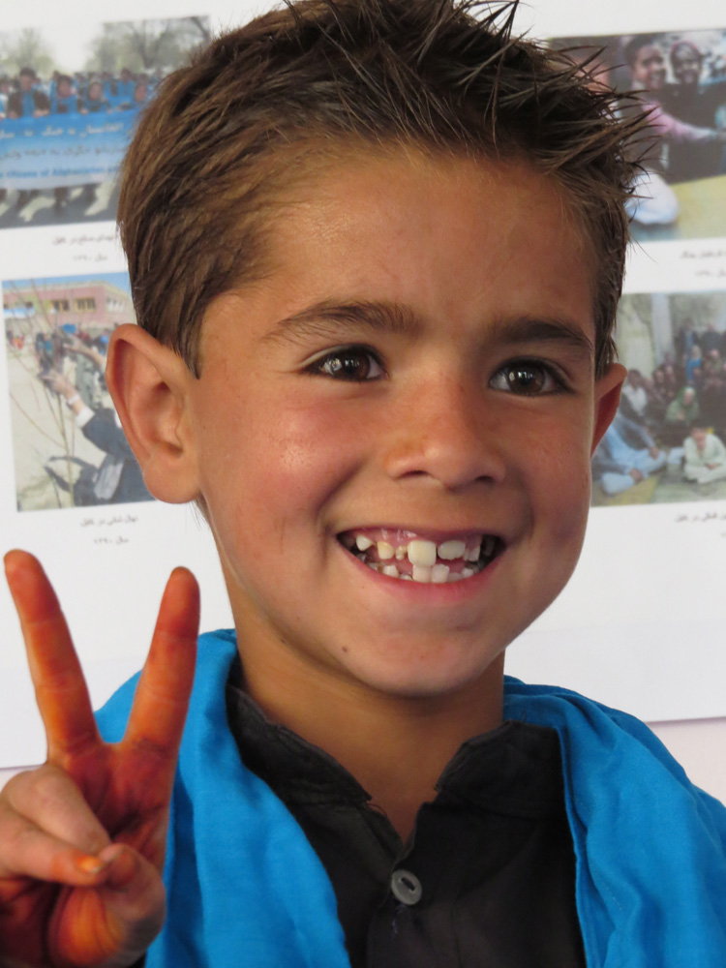
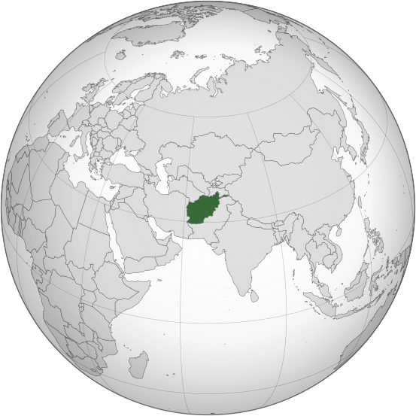
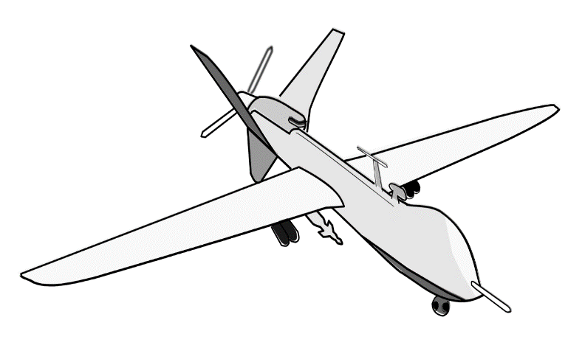
Aymel’s Story
"Afghanistan (orthographic projection)" by Shahid Parvez. Based on a file by User:Ssolbergj - (Original text: Based on File:India_(orthographic_projection).svg by user:Ssolbergj I have created this work entirely by myself.). Licensed under GFDL via Wiikmedia Commons

Slide 4
Anita’s Story

Slide 5
Children’s rights
Children have the right
to relax and play.
Children have the right
to life.
The child’s needs should come first.
Children have the right
to enough medicine,
food and clean water to
stay healthy.
Children affected by
war should get help.
Children have the right
to education

Slide 6
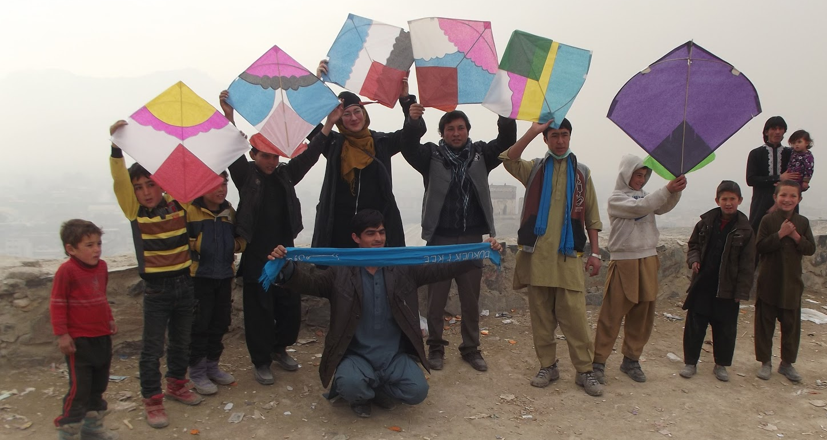
What would you wish?

